Slide 1
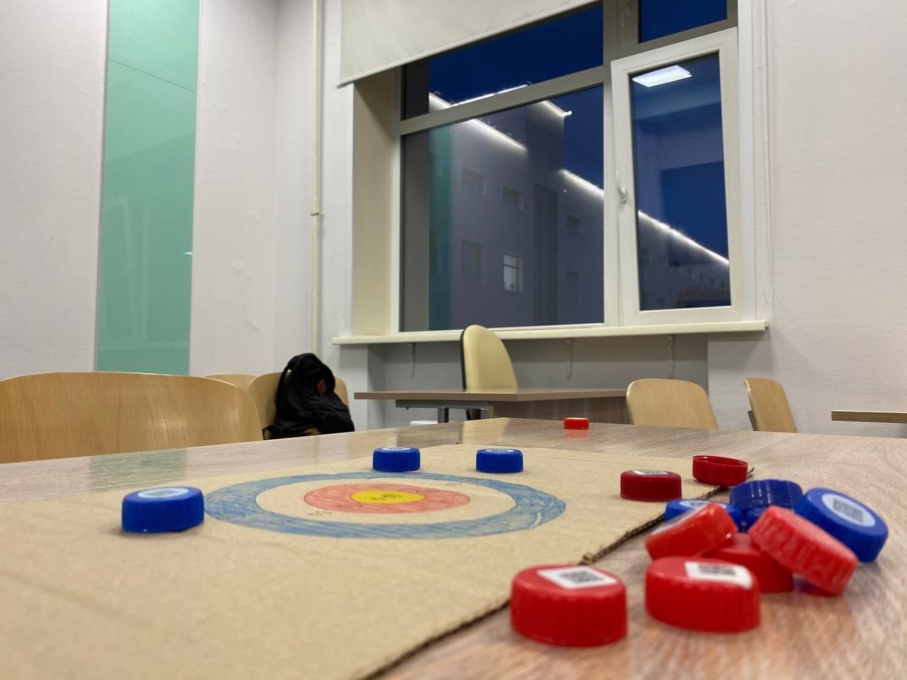
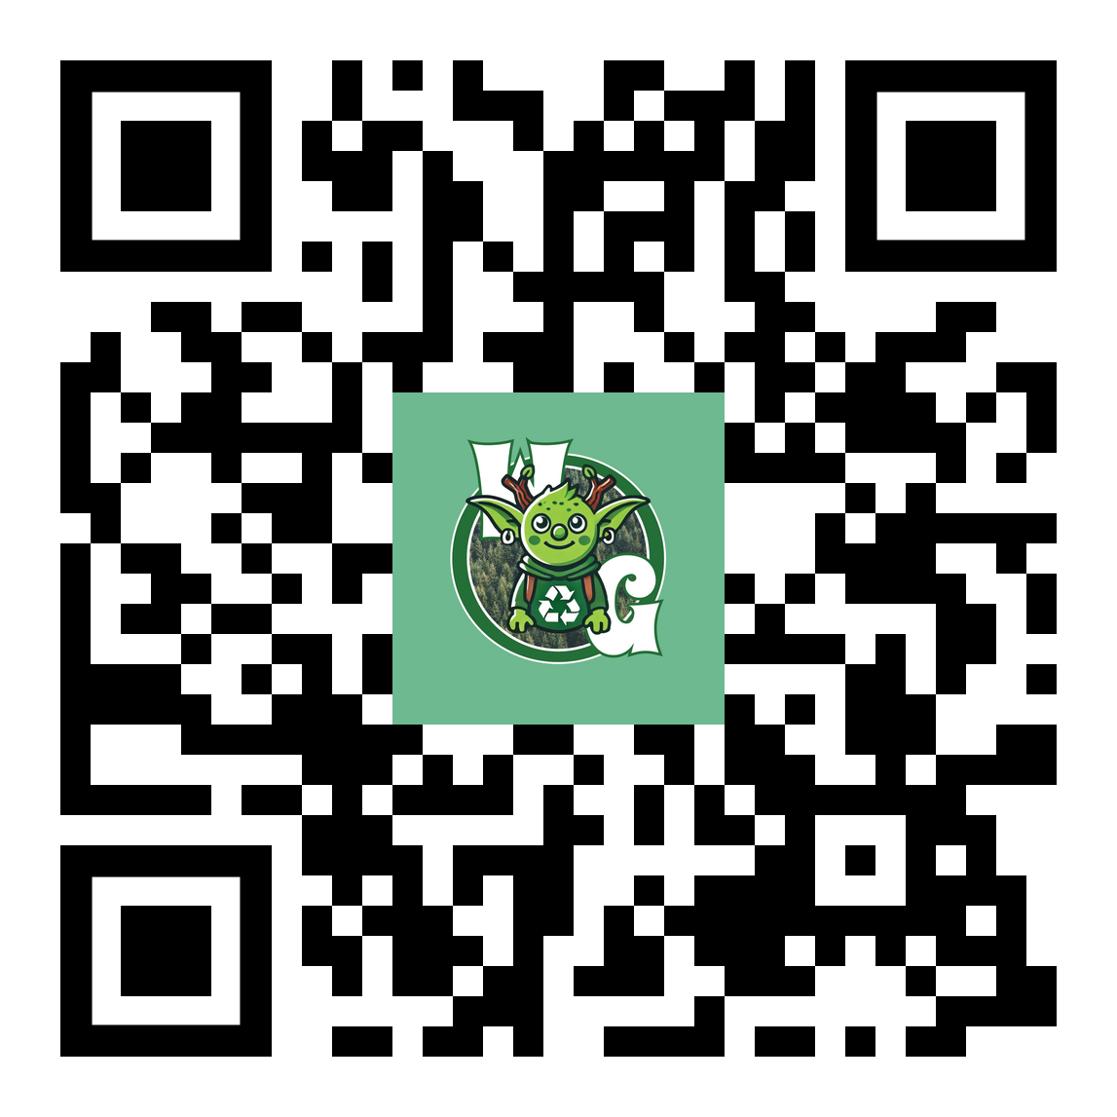
Join the "WoodGoblin" Eco Club at NSU!
We Need Volunteers!
by Rodionova E.S 24944
The "Wood Goblin" Eco Club at NSU is looking for active and caring students to join our team! We organize waste collection and recycling events, hold educational lectures and workshops, participate in greening the campus and city, and support environmental initiatives and projects. Our goal is to create a community of activists ready to change the world!
One of the club's activities is the production of board games from recyclable materials
Who Are We Looking For?
How to Respond?
We want energetic, responsible, and creative people who can work in a team and share their ideas. If you are passionate about the environment and want to make a difference, we want you!
If you would like to join our club and learn more, please contact us on social media. For participating in the club, you can earn points to receive PGAS!

